Slide 1
PROJECT REPORT ON “Easy Bill” FOR IOCONNECT SOFTWARE SOLUTIONS PRIVATE LIMITED BY Pallavi Suryawanshi SAVITRIBAI PHULE PUNE UNIVERSITY MASTERS OF COMPUTER APPLICATION SINHGAD INSTITUTE OF MANAGEMENT 2015-2018

Slide 2
Introduction
Easy Bill is powerful, User friendly and easy to use and is designed and developed to deliver real conceivable benefits to Business.
Easy Bill is web application developed to fulfill need of the businessesWhere the business need daily accounting software, maintaining billing records, maintaining credit, debit information.
Easy Bill web application is very useful for small business as well as big turn over business. It is designed to make billing system easy. As Now GST Introduce it is mandatory for business to fill GST Return. For that detailed information of account, billing has to be given. So using this Business owner can easily make bill, maintain credit debit details and send that details to Chartered Accountant to file Tax File.

Slide 3
Scope of project:
Proposed system has to work under the wireless network. Hence it has web application. In which Business owner can register their firm, maintain product detail like stock, price online also make bill manage customer detail. Owner can Maintain DEBIT CREDIT information.
This project is very useful for filing GST return online. Business owner can send Tax Bill (Sales), Purchase Bill, Account detail on one click to the CA(Chartered accountant).
.

Slide 4
Proposed System:
Business Owner can register their business here, and promote online.
BUSINESS Owner Admin have login page.
Can add stock detail of product.
Can make bill Online give print and save.
Accept payment Online

Slide 5
Existing System:
Currently all work done by manually.
Bill Book should have to maintain.
No auto calculation for bill.
Stock IN/Out not maintained.
All bill and transaction detail manually send to CA.

Slide 6
Module:
This site consists of following modules:
Admin:
Login to website.
See Business Request To Register
Approve Business.
Remove Business.
Business Owner:
Visit to website.
Register on website(DEMO).
Register And Make Payment.
Add Business detail.
Add Product Detail/Update
Make Bill.
Add customer.
Accept Payment.
Send detail To CA.

Slide 7
Module
Login Module:
In this module, admin can login using master login.
User registers on website for demo and login.
Business Module:
Admin can see Business request to register.
Admin can approve Business.
Admin can remove Business.
Add Module:
Business Owner adds Business details.
Business Owner adds Product details.
Business Owner adds Customer.
Bill Module:
Customers can make bill online.
Payment Module:
Accept payment from customer.
Report Module:
Send details to CA.

Slide 8
Hardware and Software Specifications:-
Software Specifications
Operating System: Windows 7.
Database: MYSQL 5.0
Browser: Microsoft Internet Explorer.
Framework: jdk8.0
Tools and IDE:netbean
Technologies: Java,JSP,Servlet,AngularJs
Hardware Specification:
Processor: Intel Pentium IV or More
Ram: 512 MB Ram
Hard Disk: PC with 40GB

Slide 9
Feasibility Study:
Preliminary investigation examine project feasibility, the likelihood the system will be useful to the organization. The main objective of the feasibility study is to test the Technical, Operational and Economical feasibility for adding new modules and debugging old running system. All system is feasible if they are unlimited resources and infinite time. There are aspects in the feasibility study portion of the preliminary investigation:
Technical Feasibility
Operation Feasibility
Economic Feasibility

Slide 10
Operational Feasibility:
Proposed projects are beneficial only if they can be turned out into information system. That will meet the organization’s operating requirements. Operational feasibility aspects of the project are to be taken as an important part of the project implementation. Some of the important issues raised are to test the operational feasibility of a project includes the following: -
Is there sufficient support for the management from the users?
Will the system be used and work properly if it is being developed and implemented?
Will there be any resistance from the user that will undermine the possible application benefits?

Slide 11
Economic Feasibility:
A system can be developed technically and that will be used if installed must still be a good investment for the organization. In the economic feasibility, the development cost in creating the system is evaluated against the ultimate benefit derived from the new systems. Financial benefits must equal or exceed the costs. The system is economically feasible. It does not require any addition hardware or software. Since the interface for this system is developed using the existing resources and technologies available at NIC, There is nominal expenditure and economical feasibility for certain.

Slide 12
Fact Finding Techniques
To study any system the analyst needs to do collect facts and all relevant information. The facts when expressed in quantitative form are termed as data. The success of any project is depended upon the accuracy of available data. Accurate information can be collected with help of certain methods/ techniques. These specific methods for finding information of the system are termed as fact finding techniques. Interview, Questionnaire, Record View and Observations are the different fact finding techniques used by the analyst. The analyst may use more than one technique for investigation.
Interview
Questionnaire
Record View
Observation

Slide 13
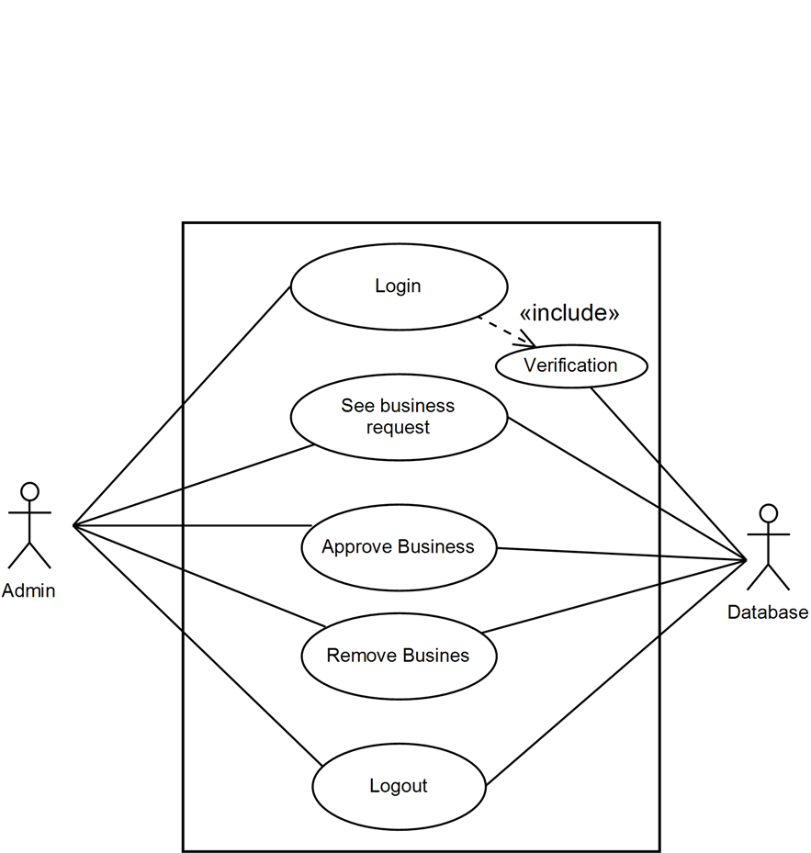
USE CASE ADMIN:-

Slide 14
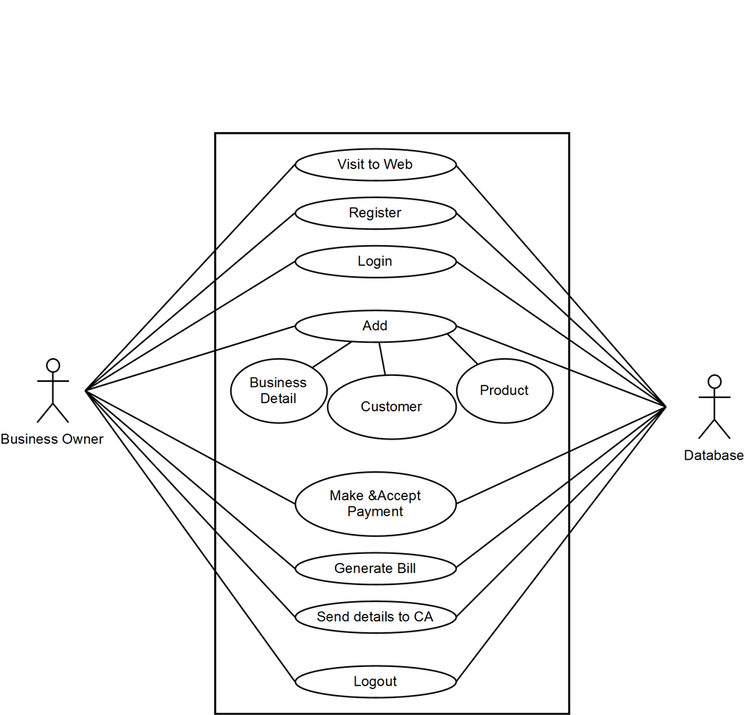
BO(BUSINESS OWNER) USE OWNER:-

Slide 15
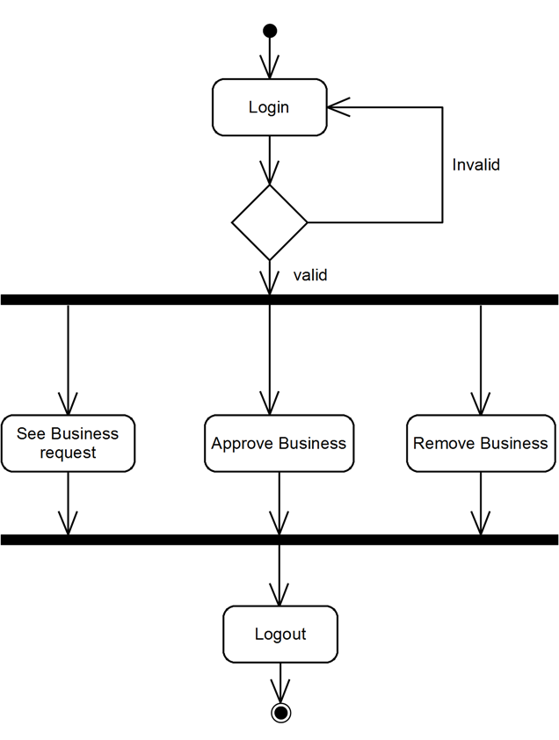
Activity:
Admin

Slide 16
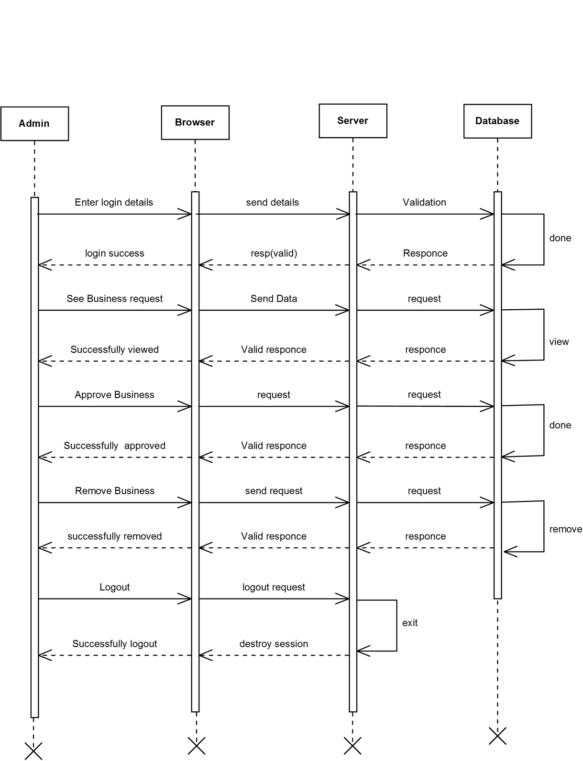
Sequence
Sequence
Admin:-

Slide 17
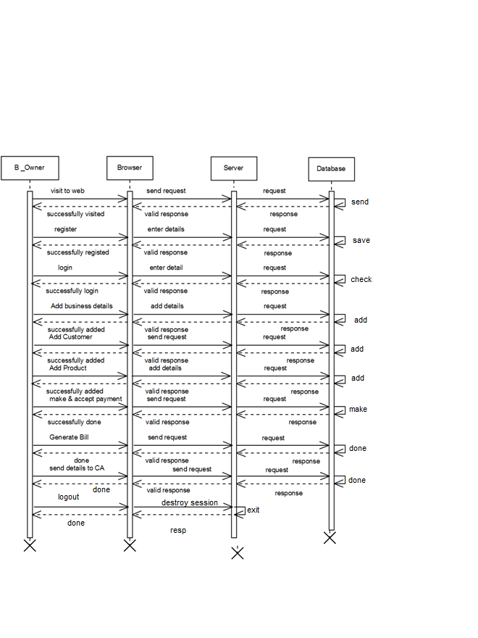
BO:-

Slide 18
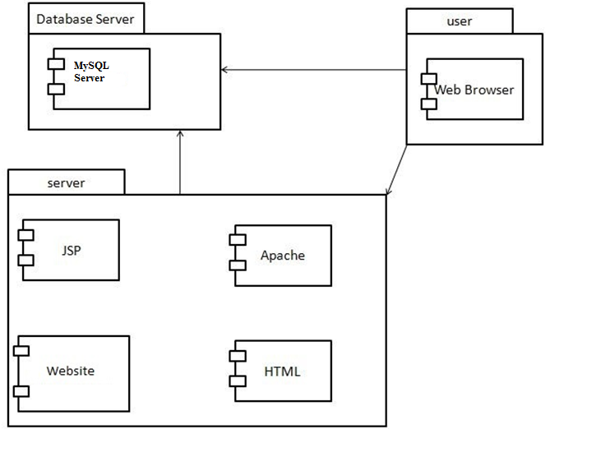
Component Diagram

Slide 19
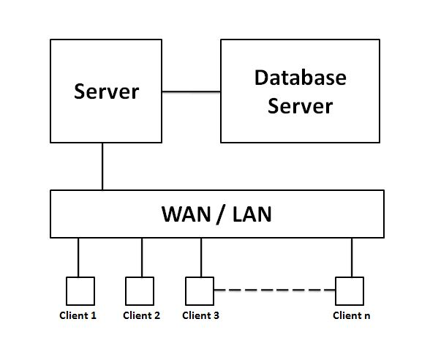
Deployment Diagram

Slide 20
Thank You

